Slide 1


Introduction to the hack
Dougal Fleming (Dedalus)
Steve Harris (NHS England)

Slide 2

Git repo
https://github.com/dfleming9/interopen-hack

Slide 3


Shared Toys
Ontoserver sandpit
https://ontoserver.hackathon-2025.dc4h.link/fhir
Open access
HAPI FHIR Server
https://hapi-server.hackathon-2025.dc4h.link/fhir
Open access

Slide 4

Useful Tools
Shrimp (terminology browser)
https://ontoserver.csiro.au/shrimp/launch.html?iss=https://ontoserver.hackathon-2025.dc4h.link/fhir

Slide 5

Useful Tools
Snapper (terminology authoring)
https://ontoserver.csiro.au/snapper/?iss=https://ontoserver.hackathon-2025.dc4h.link/fhir

Slide 6



Questionnaire Tools
https://lhcformbuilder.nlm.nih.gov/
http://lhncbc.github.io/lforms/
https://github.com/aehrc/smart-forms

Slide 7
Content
Terminology Content (latest versions)
SNOMED UK (with added IPS)
dm+d
ICD10/NICIP/HPO etc.
FHIR R4 CodeSystems/ValueSets
Loinc
Ask if you need more … or load it yourself

Slide 8


Examples
Postman Collections
https://github.com/NHSDigital/terminologyserver
https://www.postman.com/interopenhack/interopen2025hack/collection/4yd7a83/hackathons

Slide 9
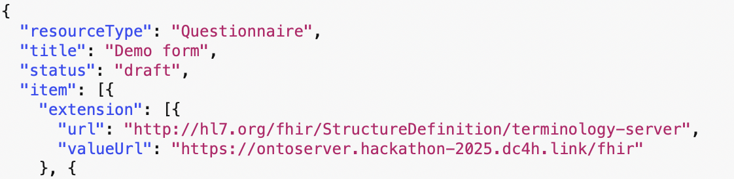
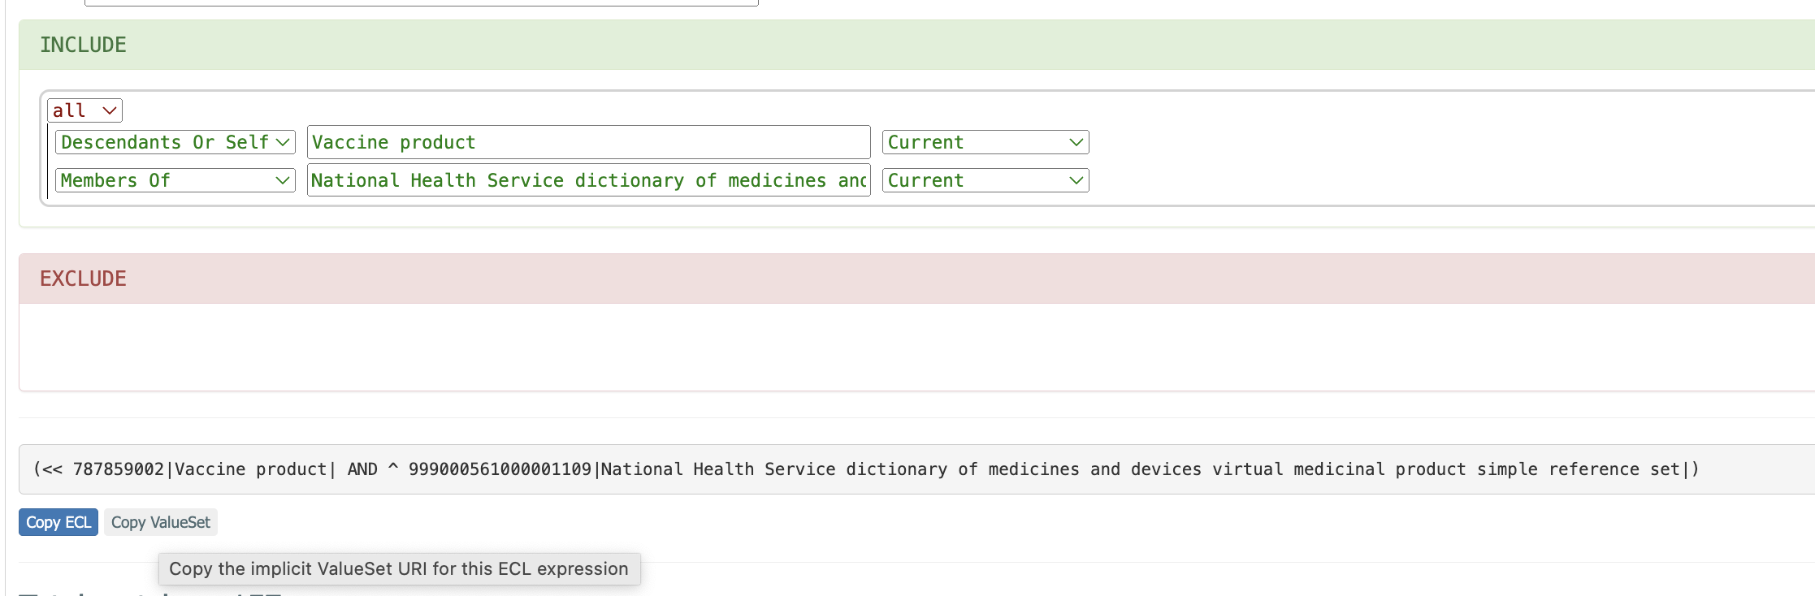
Starter Forms Demo
https://formbuilder.nlm.nih.gov/#

Slide 10
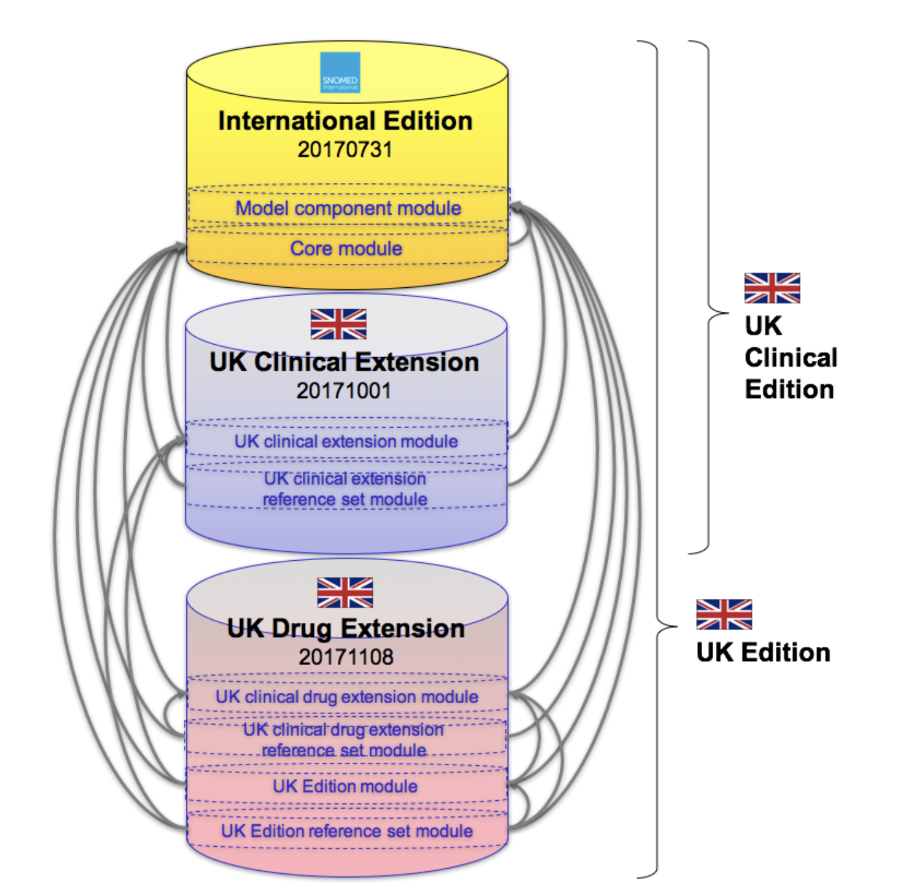
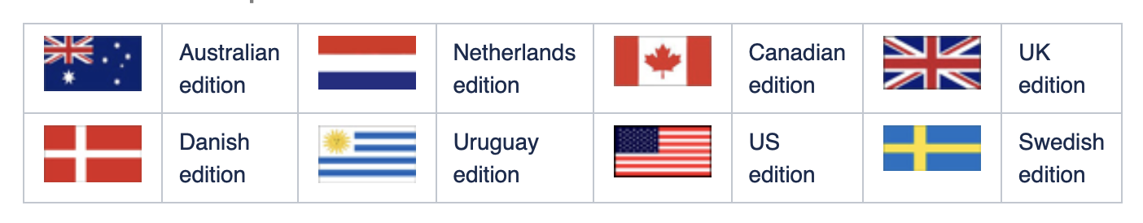
Sharing SNOMED terminology
UK Edition
Example national editions
https://confluence.ihtsdotools.org/display/DOCEXTPG/4.4.1+National+Editions

Slide 11
SNOMED International Patient Summary (IPS)
Designed to standardize and record basic medical data that includes the most important clinical information to patient safety and healthcare.
The SNOMED CT IPS refset terms have been harmonized with and supports the contents of the HL7 International Patient Summary (HL7 IPS) and CEN's European Standard for the Patient Summary.
IPS has 11,380 terms vs. UK SNOMED 1,116,441 terms

Slide 12
Interoperability with terminology
General principle:
Send both (detail and IPS)
Which IPS concept to use?

Slide 13

Interoperability with terminology
General principle:
Send both (detail and IPS)
Which IPS concept to use?

Slide 14
ECL
bottom(ancestorof 230400008 | Opercular epilepsy | AND memberof 816080008 | International Patient Summary |)
aka
!!<(>230400008 AND ^816080008)
Generalised:
!!<(>uk-snomed-code AND ^816080008)

Slide 15
Overall scenario
Public health emergencies require rapid responses, deploying interoperable information systems rapidly
Hackathon sandpit resources cover a general story arc
Recording immunisation events
Storing immunisation event details
Extracting FHIR resources from the records
Bundling/transforming resources into summary components
… and relevant specifications, server resources and sample data for you to hack at the bits that interest

Slide 16
FHIR Immunization resource instances
NHS FHIR R4 randomised sample data provided on the FHIR server
15 patients
3 practitioners
60 realistic vaccination events for Covid 19, Influenza and MMR
Gives you a clue as to what information you might want to model in your FHIR questionnaire if you’re hacking at that part
Gives you some demo data if/when you want to work on the downstream bits

Slide 17
Detailed questionnaire example
A detailed questionnaire example is available
Demonstrates sections, questions and various answer types
Static and dynamic valuesets
Examples of SNOMED CT ECL
‘Skip logic’ examples built in

